Slide 1
Power BI -Charts
Use Cases of charts

Slide 2
Thumb rules of creating Visualization :
Below few points we need to ask ourself before creating any visualization
Who is our Business User for report I create ? Will they be familiar of visuals I create ?
Will the visual suited for the specific data from semantic model? Will data portray it accurately by visuals which created?
What you want to tell with this visual? Does it provide meaningful insights to the Business users ?

Slide 3

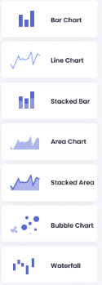
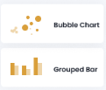
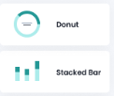
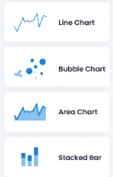



Choose Your Visuals:
Compare Values against One or Multiple fields
Data Over Time Filed
Distribution of Data by Fields
Summarization At Whole
Top Ranks (Ex: Top 5 or Bottom 5)

Slide 4
High Level Information of Charts
Choose your Power BI visuals based on the type of insight as follows:
Data Comparison:-- Bar Chart, Grouped Bar, Line Chart, Bubble Chart, Area Chart, Stacked Bar, Ribbon, Shape Map, Donut, Tree map
Data Over Time :-- Bar Chart, Line Chart, Stacked Bar, Area Chart, Stacked Area, Bubble Chart, Waterfall
Data Distribution: - Bubble Chart, Grouped Bar
Part-to-Whole - Donut, Stacked Bar, Tree map
Ranking - Ordered Column, Ordered Bar, Ribbon, Funnel

Slide 5
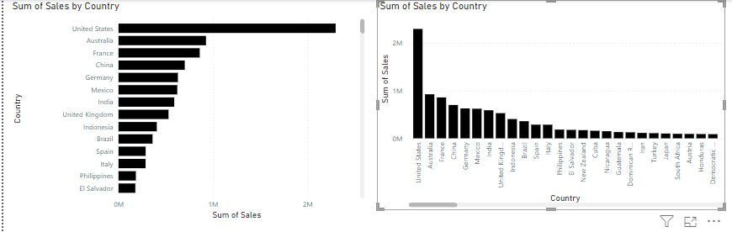
Bar Charts
Bar charts are mostly used graphs because they are simple to create and easy to understand. Bar charts are also called horizontal charts that represent the absolute data. They are useful to display the data that include negative values because it is possible to position the bars above and below the x-axis.
Ex: The Below image shows the comparison of Sales trends in different countries

Slide 6
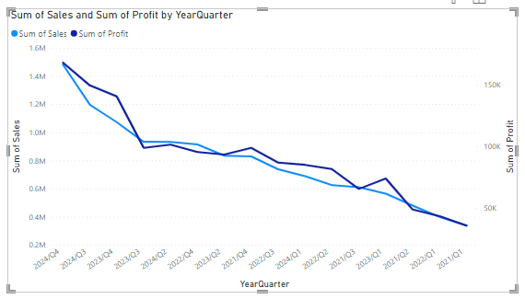
Line Chart
Line charts are mostly used charts to represent the data and are characterized by a series of data points connected by a straight line. Each point in the line corresponds to a data value in the given category. It shows the exact value of the plotted data. Line charts should only be used to measure the trends over a period of time, e.g. dates, months, and years
For Instance:
The below line chart shows the Sales and Profits by year and quarter filed

Slide 7
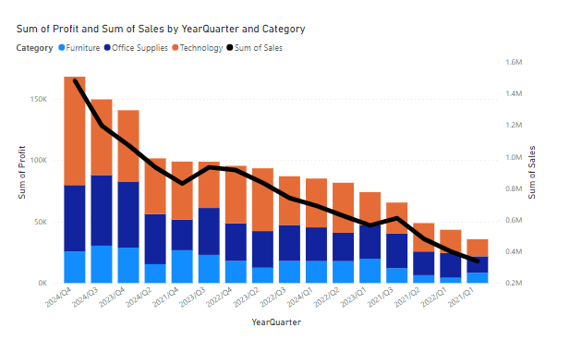
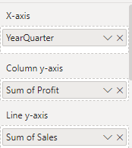

Combo Charts
A combo chart is a combination of both the column charts and line charts that help you to make a quicker comparison of the data. The combo chart shows the relationship between two measures in a single visualization. It also helps to compare multiple measures with different values

Slide 8
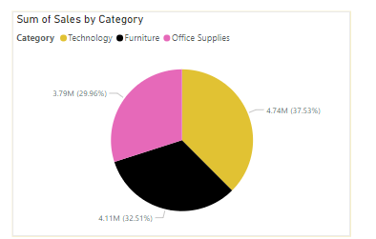
Pie Charts
A pie chart is a circular statistical chart, and it shows the whole data in parts. Each portion of a pie chart represents the percentages, and the sum of all parts should be equal to 100%. The whole data can be divided into slices to show the numerical propositions of each part of the data. Pie charts are mostly used to represent the same category of data. It helps users to understand the data quickly. They are widely used in education, the business world, and communication media.
For Ex : In the below Pie chart, it is clearly programming to show high level sales segregated by category.

Slide 9
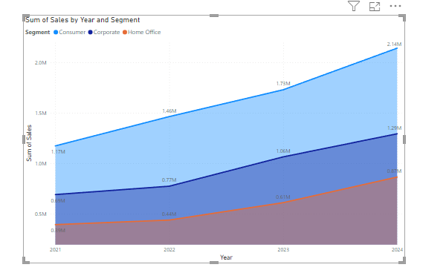
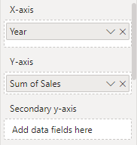

Area Chart
The area chart depends on line charts to display quantitative graphical data. The area between the axis and lines is commonly filled with colors, textures, and patterns. You can compare more than two quantities with area charts. It shows the trend changes over time and can be used to attract the attention of the users to know the total changes across the trends.
For Instance:
The below Area chart clearly shows you how the Sales of Year and Segment over the past 4 years.

Slide 10
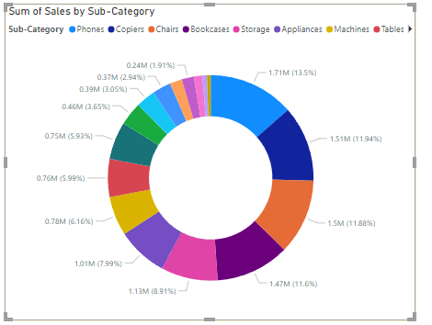
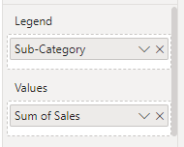
Doughnut Charts
Doughnuts are similar to pie charts, and it is named doughnut chart because it looks similar to a doughnut. You can easily understand the data because doughnut charts show the whole data into the proposition. It is the most useful chart when you need to display various propositions that make up the final value

Slide 11
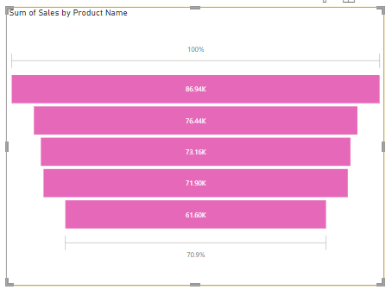
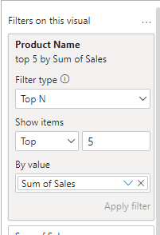
Funnel Charts
The funnel chart is a type of chart which is used to visualize the data that flows from one phase to another phase. In the funnel chart, the whole data is considered as 100%, and in each phase, it is represented as numerical propositions of the data
Ex : Top 5 products

Slide 12
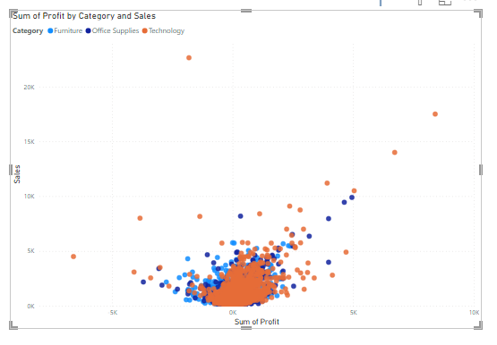
Bubble Chart
Bubble charts show the data in the form of a circle. The values of the variables are represented by the x-axis and y-axis. The size of the circle represents the measure of the variable
For Instance:
In the below bubble chart, you can observe that on X-axis, Profit is measured and Y axis Sales is measured and Colored by category

Slide 13
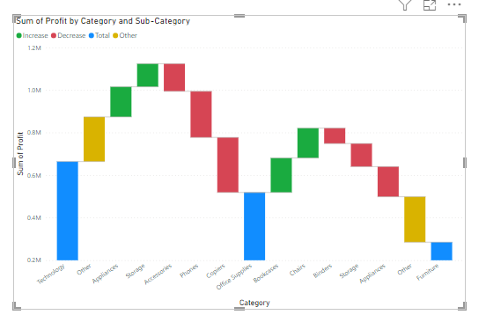
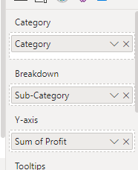
Waterfall Charts
A waterfall chart is used to show how initial values are increasing and decreasing gradually by a series of values to arrive at the final value.
For Instance:
Let us consider an example in which you can plot your company's annual profit in different Category and Subcategory

Slide 14
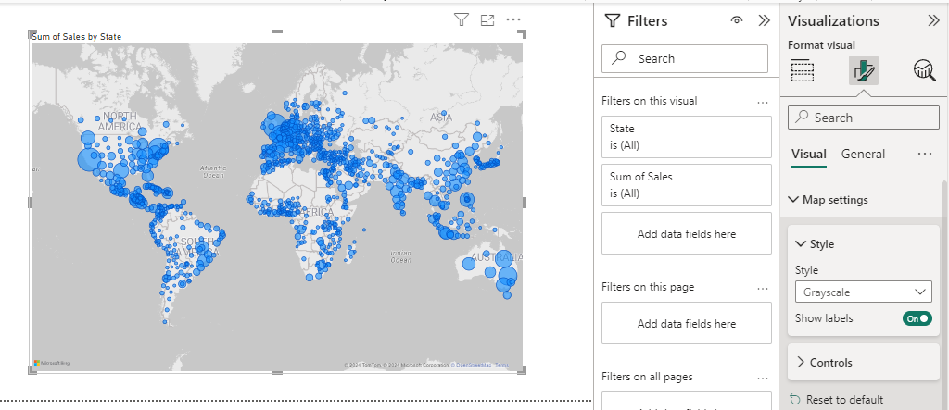
MAP
Map is used to represent the geographical distribution of data by plotting the same size points on the geographical background. It helps the user to grasp the overall distribution of the data, but it is a tough task if you want to observe specific data

